Slide 1
5.Machining Operations
CO:-Describe construction, working of lathe and drilling machines andmanufacture simple job.
Visit for more Learning Resources

Slide 2
Lathe Operations

Slide 3
Agenda
Introduction to Machining
Processes
Parameters
Turning
Types of Cuts
Lathe Terminology
Process Parameters

Slide 4
Bonus Quiz 1
Name the three primary parameters that must be specified for a machining operation.
These three parameters allow us to decide if we have the power to physically perform the operation. What (three letters) calculation can we get from the primary parameters to begin to address the necessary power requirements?

Slide 5
Manufacturing Operations
Four classes of Processing Operations:
Solidification Processes
Particulate Processes
Deformation Processes
Material Removal Processes
Two classes of Assembly Operations:
Mechanical Assembly
Joining

Slide 6
Machining
Variety of work materials can be machined
Most frequently applied to metals
Variety of part shapes and special geometry features possible, such as:
Screw threads
Accurate round holes
Very straight edges and flat surfaces
Good dimensional accuracy and surface finish
Wasteful of material
Chips generated in machining are wasted material, at least in the unit operation
Time consuming
A machining operation generally takes more time to shape a given part than alternative shaping processes, such as casting, powder metallurgy, or forming

Slide 7
Machining Operations
Generally performed after other manufacturing processes (casting, forging, …)
Other processes create the general shape of the workpart
Machining provides the final shape, dimensions, finish, and special geometric details that other processes cannot create
Most important machining operations:
Turning
Drilling
Milling
Other machining operations:
Shaping and planing
Broaching
Sawing

Slide 8
Primary Machining Parameters
Cutting Speed – (v)
Primary motion
Peripheral speed m/s ft/min
Feed – (f)
Secondary motion
Turning: mm/rev in/rev
Milling: mm/tooth in/tooth
Depth of Cut – (d)
Penetration of tool below original work surface
Single parameter mm in
Resulting in Material Removal Rate – (MRR)
MRR = v f d mm³/s in³/min
where v = cutting speed; f = feed; d = depth of cut

Slide 9
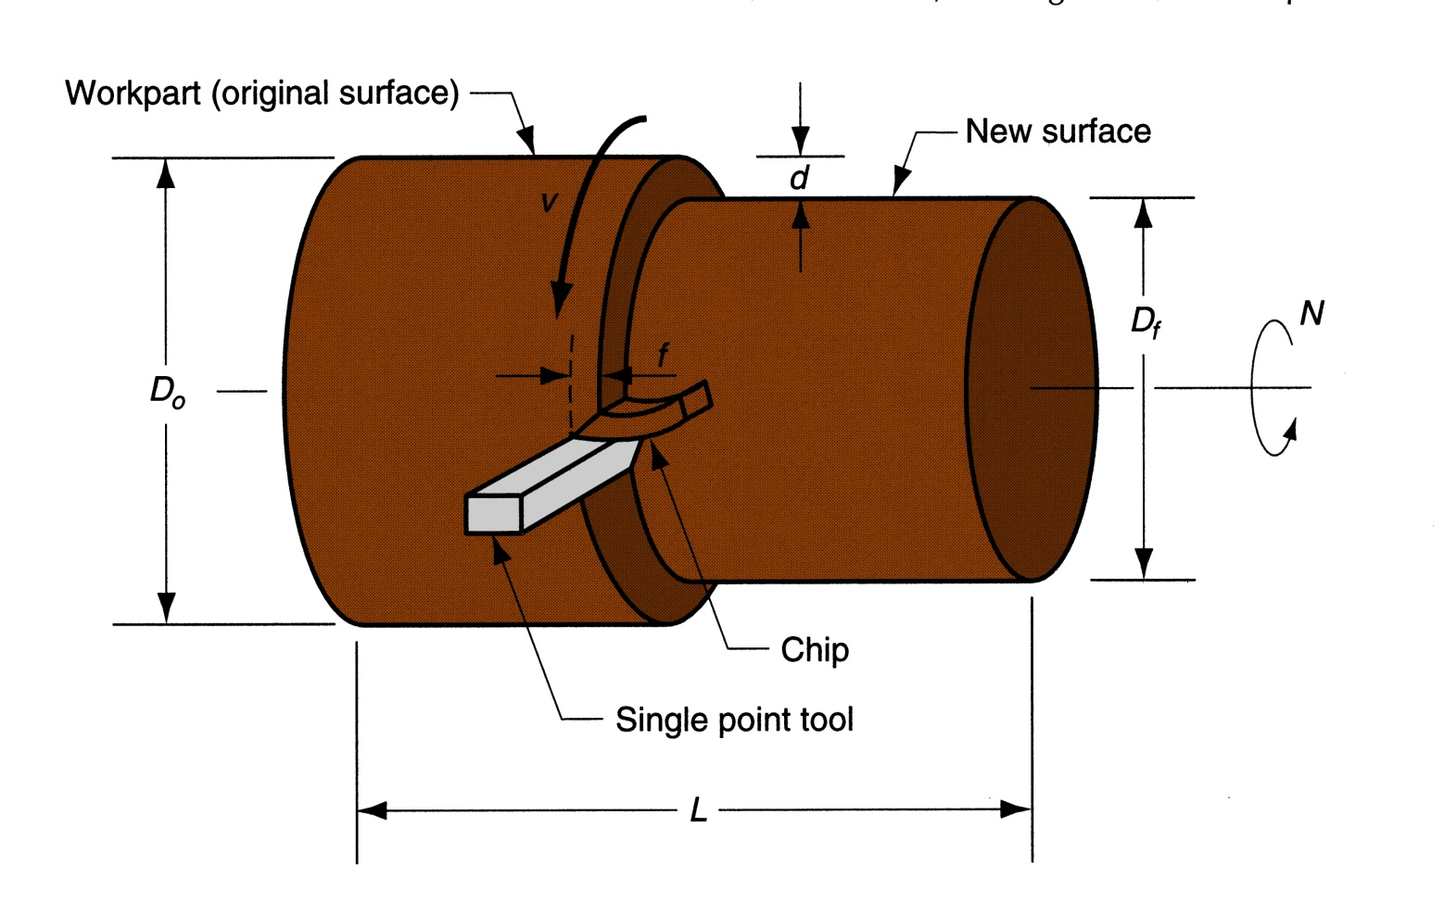
Turning Parameters Illustrated
Figure 22.5 ‑ Turning operation [Groover (2004), p.503]

Slide 10
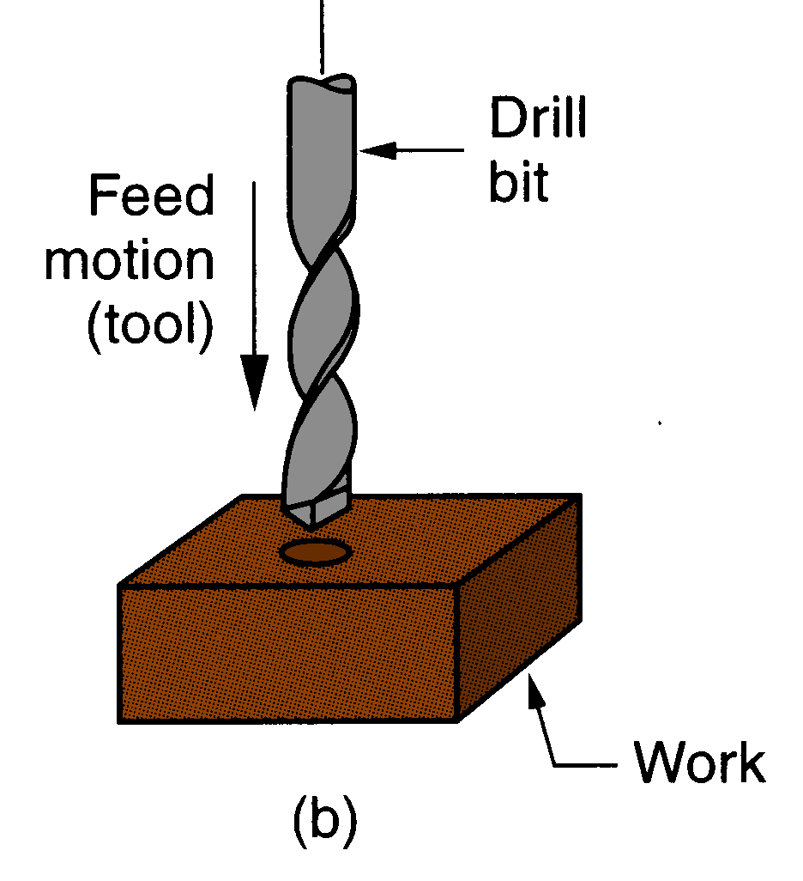
Drilling
Creates a round hole in a workpart
Contrasts with boring which can only enlarge an existing hole
Cutting tool called a drill or drill bit
Customarily performed on a drill press
Figure 21.3 (b) drilling
[Groover (2004), p.501]

Slide 11
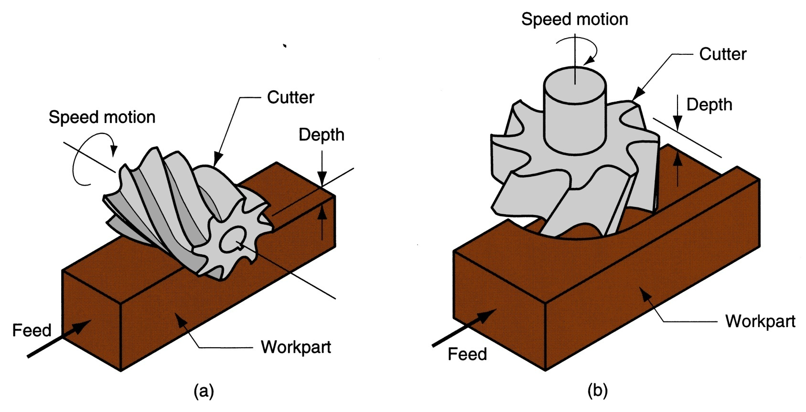
Milling Parameters Illustrated
Figure 21.3 ‑ Two forms of milling:
(a) peripheral milling, and (b) face milling
[Groover (2004), p.516]

Slide 12
Machining Operations & Parameters
Operation Type | Speed | Feed | Depth of Cut
Turning: workpiece rotates single point cutting | Surface speed (periphery) of workpiece | Parallel to the workpiece axis* (*except parting/grooving) | Tool penetration below original work surface
Drilling: tool rotates single pass cutting | Surface speed (periphery) of tool | Parallel to the tool axis | Tool penetration below original work surface (depth of hole)
Milling: tool rotates multi-point cutting | Surface speed (periphery) of tool | Perpendicular to the tool axis | Tool penetration below original work surface

Slide 13
Cut Types: Roughing & Finishing
Cut Type | Number of Passes | Speed | Feed | Depth of Cut
Roughing: removes large amounts to get close to shape | 1 + | Low | High 0.4 - 1.25 mm/ .015 - .050 in/ | High 2.5 - 20 mm .100 - .750 in
Finishing: achieves final dimensions, tolerances, and finish | 1 - 2 | High | Low 0.125 - 0.4 mm/ .005 - .015 in/ | Low 0.75 - 2.0 mm .030 - .075 in

Slide 14
Turning
A single point cutting tool removes material from a rotating workpiece to generate a rotationally symmetric shape
Machine tool is called a lathe
Types of cuts:
Facing
Contour turning
Chamfering
Parting (Cut-off) / Grooving
Threading

Slide 15
Turning Parameters Illustrated
Figure 22.5 ‑ Turning operation [Groover (2004), p.503]

Slide 16
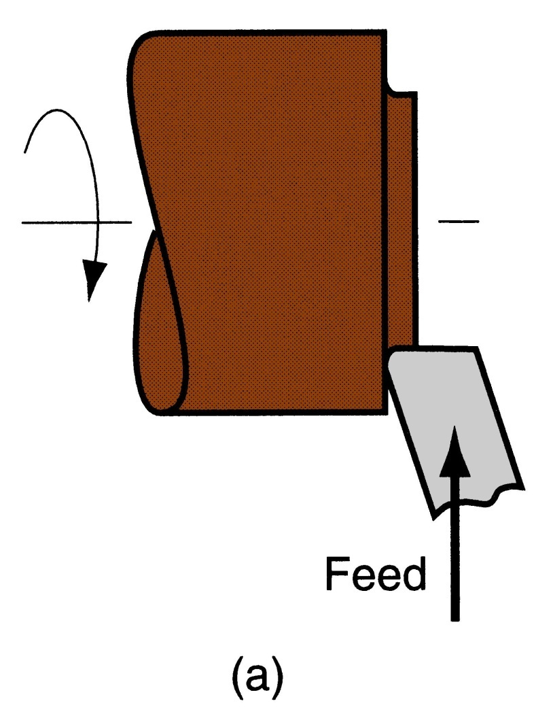
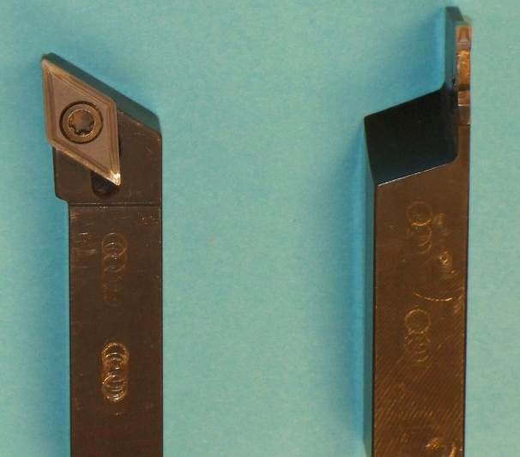
Facing
Tool is fed
radially inward
Figure 22.6 (a) facing

Slide 17
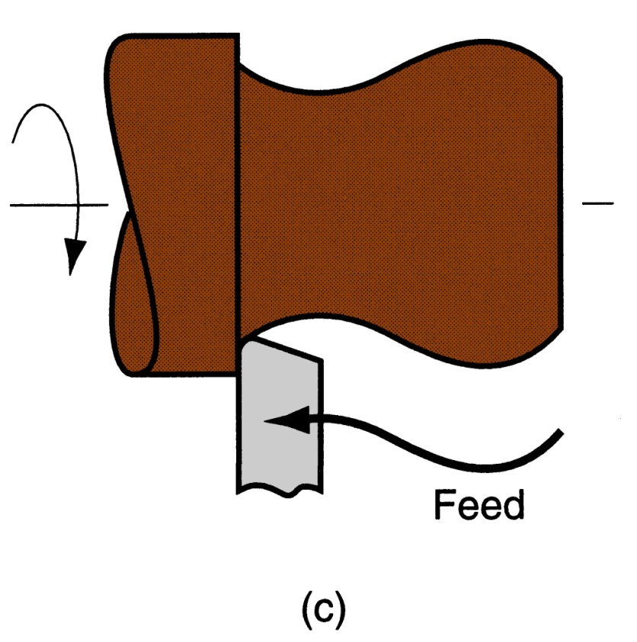
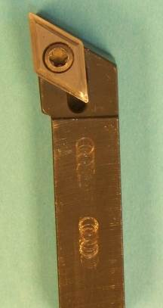
Contour Turning
Instead of feeding the tool parallel to the axis of rotation, tool follows a contour that is not necessarily straight (thus creating a contoured form).
Figure 22.6 (c) contour turning

Slide 18
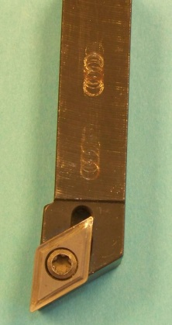
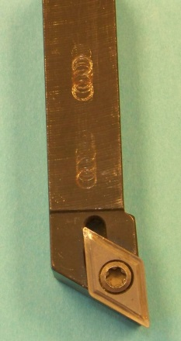
Right & Left Hand Tools
Right Hand Tool:
Cuts from right to left
Left Hand Tool:
Cuts from left to right

Slide 19
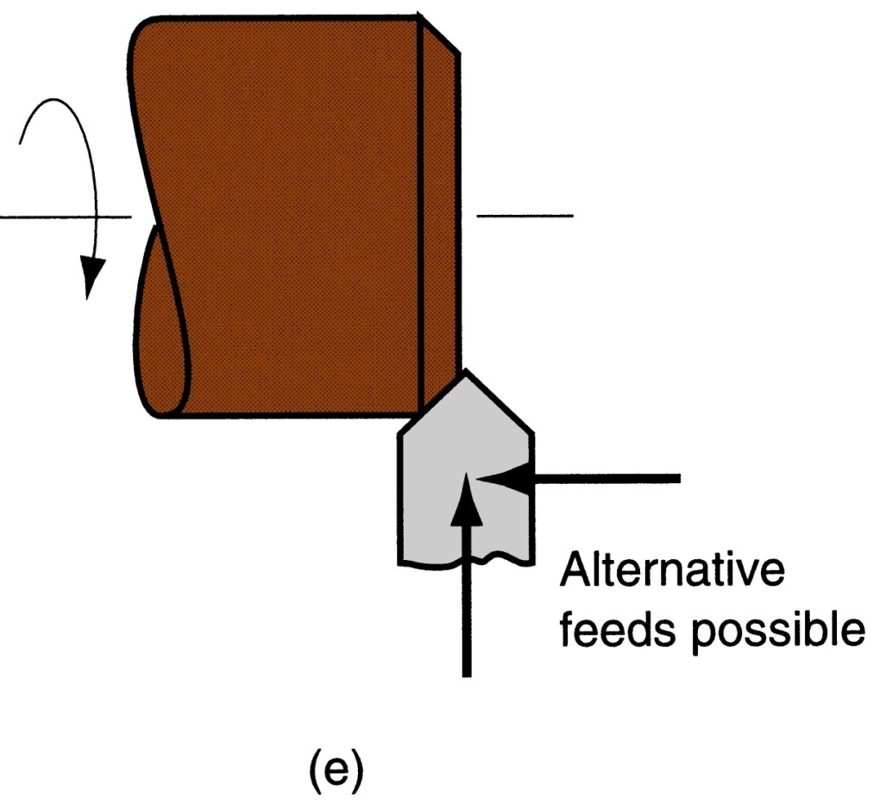
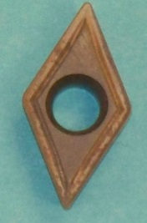
Chamfering
Cutting edge cuts an angle on the corner of the cylinder, forming a "chamfer"
Figure 22.6 (e) chamfering

Slide 20
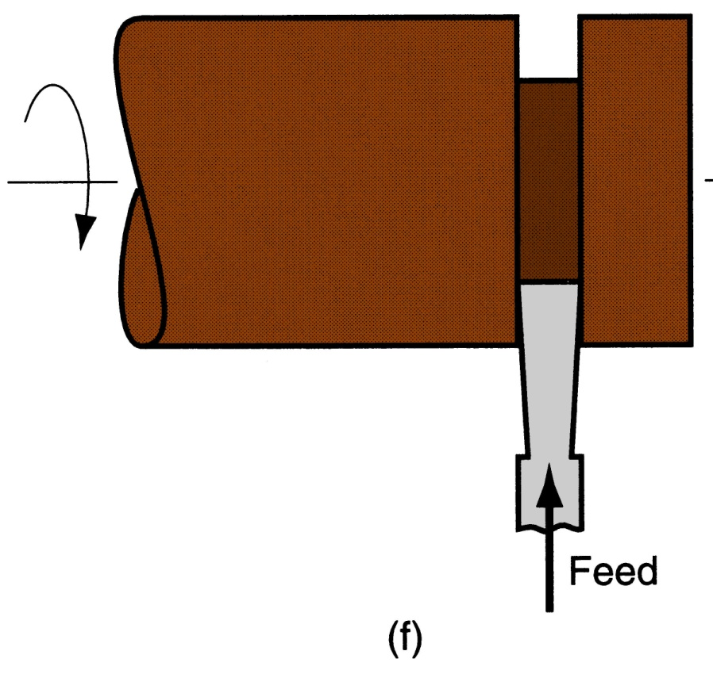
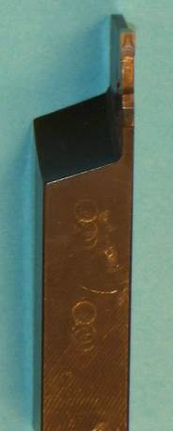
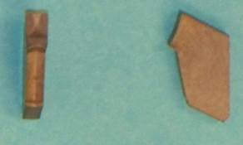
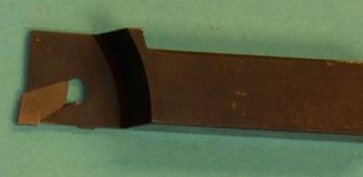
Parting (Cutoff) / Grooving
Tool is fed radially into rotating work at some location to cut off end of part, or provide a groove
Figure 22.6 (f) cutoff

Slide 21
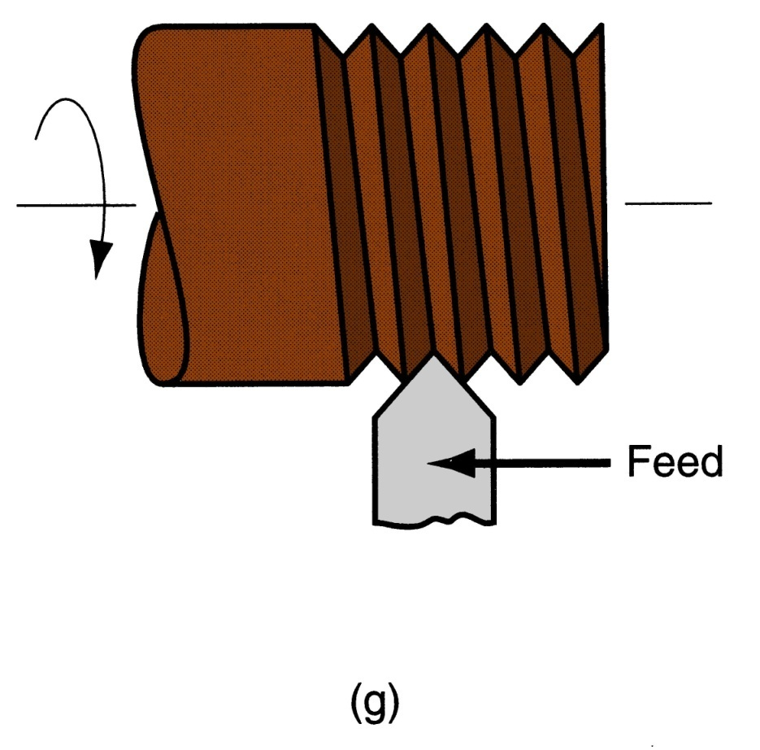
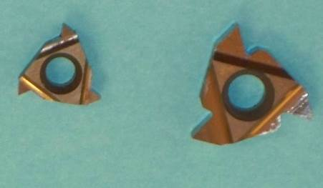
Threading
Pointed form tool is fed linearly across surface of rotating workpart parallel to axis of rotation at a large feed rate, thus creating threads
Figure 22.6 (g) threading

Slide 22
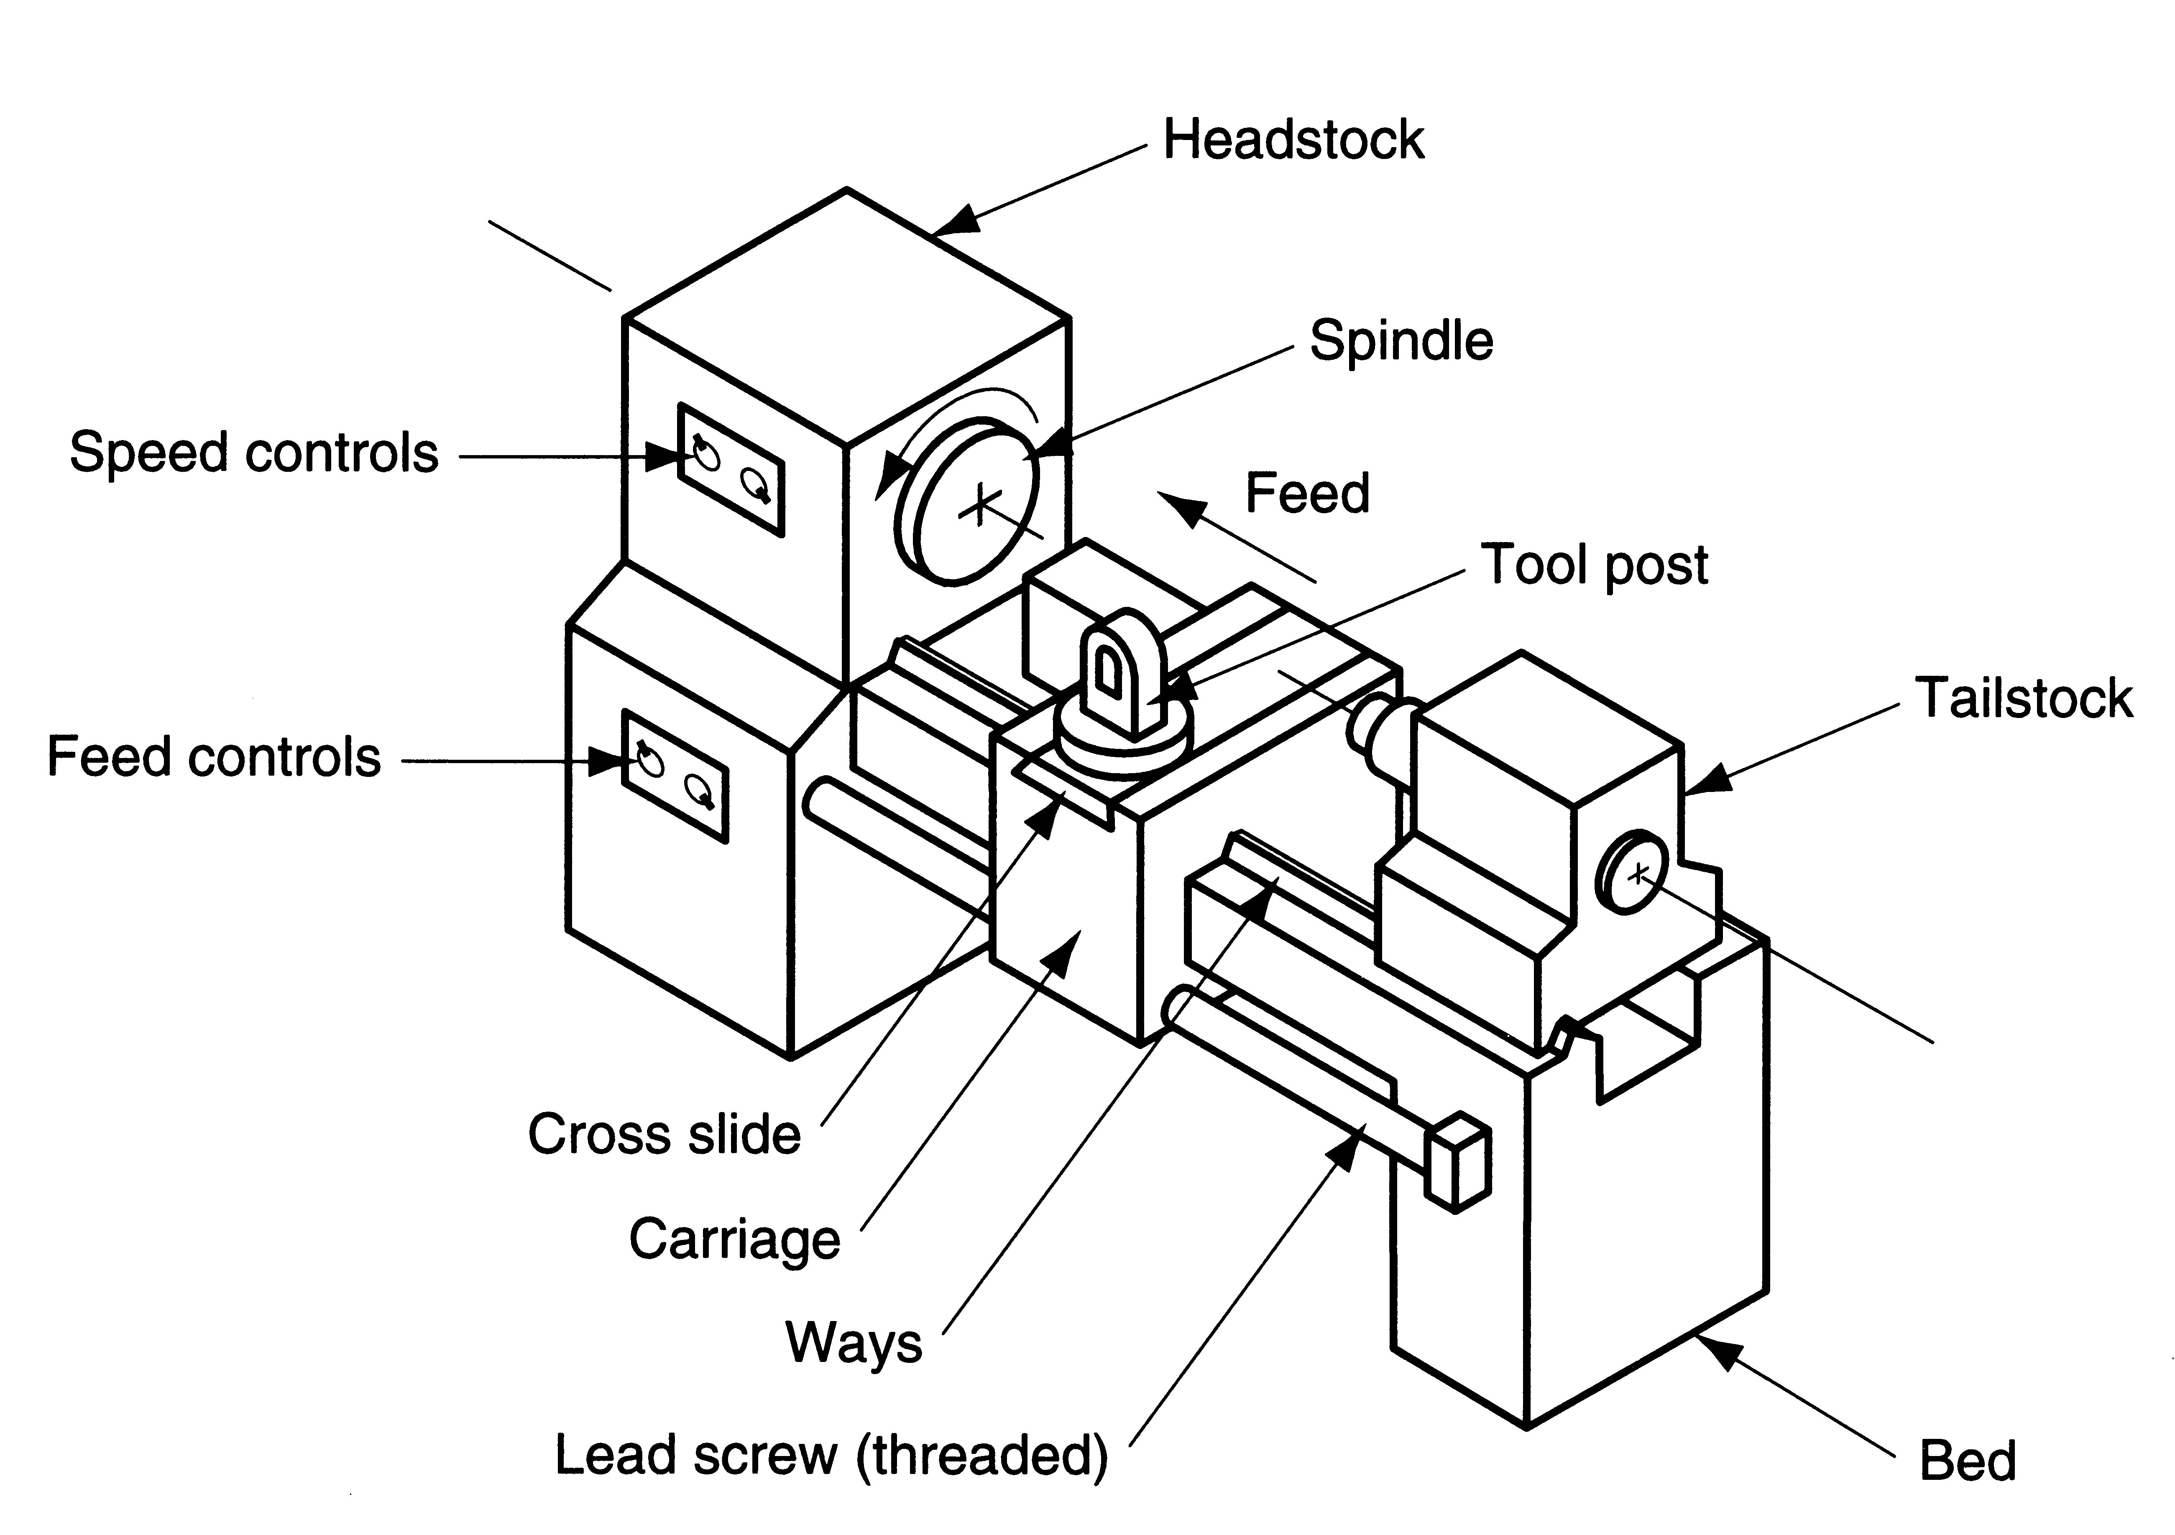
Engine Lathe
Figure 22.7
Diagram of an engine lathe, showing its principal components

Slide 23
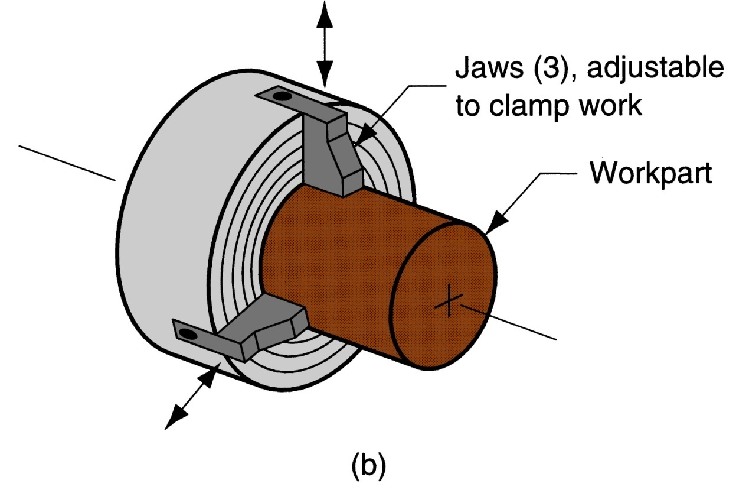
Chuck
Figure 22.8 (b) three‑jaw chuck

Slide 24
Turret Lathe
Manual operation is replaced by a “turret” that holds multiple tools
Tools are rapidly brought into action by indexing the turret
Tool post is replaced by multi‑sided turret to index multiple tools
Applications: high production work that requires a sequence of cuts on the part

Slide 25
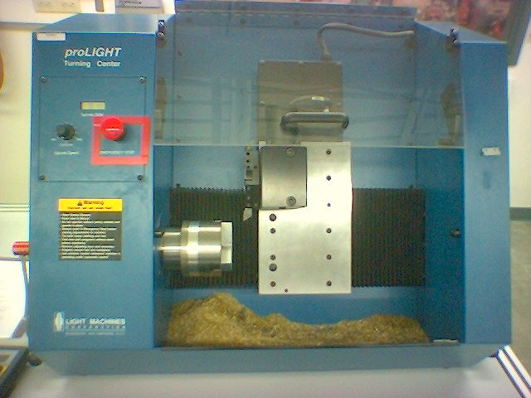
CNC Turret Lathe
Spindle Speed
Tool Turret
+ X-axis
Ways
+ Z-axis
Spindle
Cross Slide

Slide 26
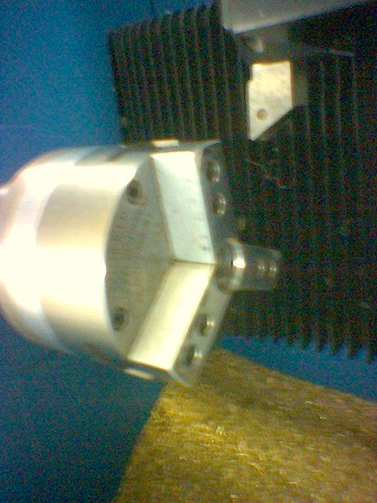
CNC Lathe: Air-Operated Chuck
Right Hand Profile Tool
Chuck

Slide 27
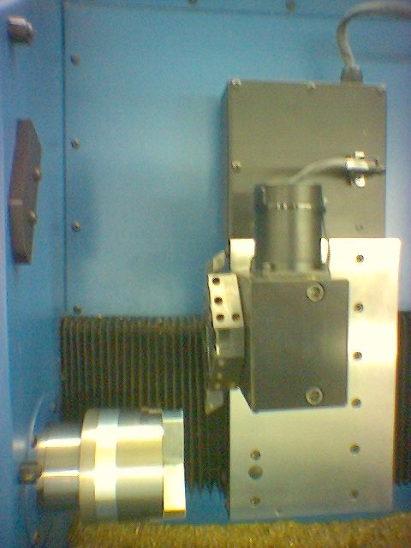
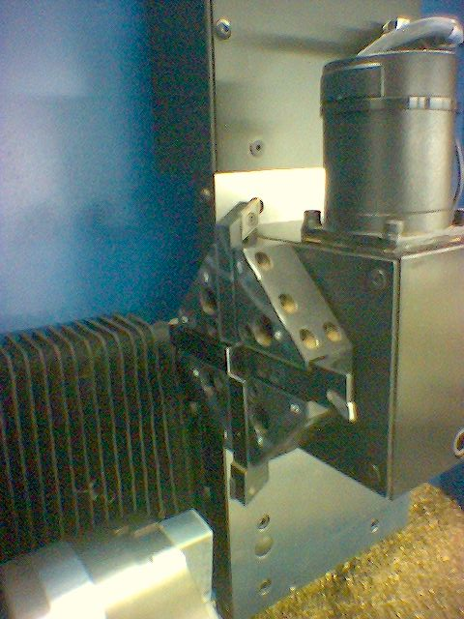
CNC Lathe: Tool Turret
Left Hand Profile Tool
Tool Turret
Grooving / Parting Tool
Tool Holder
Right Hand Profile Tool

Slide 28
Machining Calculations: Turning
Spindle Speed - N (rpm)
v = cutting speed
D_{o} = outer diameter
Feed Rate - f_{r} (mm/min -or- in/min)
f = feed per rev
Depth of Cut - d (mm/rev -or- in/rev)
D_{o} = outer diameter
D_{f} = final diameter
Machining Time - T_{m} (min)
L = length of cut
Mat’l Removal Rate - MRR (mm³/min -or- in³/min)

Slide 29
Questions & Issues
Finish Machining (Drilling & Milling) Next Week:
Next Topic: Process Planning
Following Week: Group Technology
Lab this week:
Fixturing (manual tools & drill press)
Lab next week:
Manual Lathe & Mill Operations:
Rough & Finish Profiling Cuts
Facing Cuts
Parting Cuts
Tool Changes
Touch-Off

Slide 30
Drilling Machine…

Slide 31
Drilling
Drilling is the operation of producing circular hole in the work-piece by using a rotating cutter called DRILL.
The machine used for drilling is called drilling machine.
The drilling operation can also be accomplished in lathe, in which the drill is held in tailstock and the work is held by the chuck.
The most common drill used is the twist drill.

Slide 32
Drilling Machine
It is the simplest and accurate machine used in production shop.
The work piece is held stationary ie. Clamped in position and the drill rotates to make a hole.
Types :-
a) Based on construction:
Portable, Sensitive,Radial, up-right, Gang, Multi-spindle
b)Based on Feed:
Hand and Power driven

Slide 33
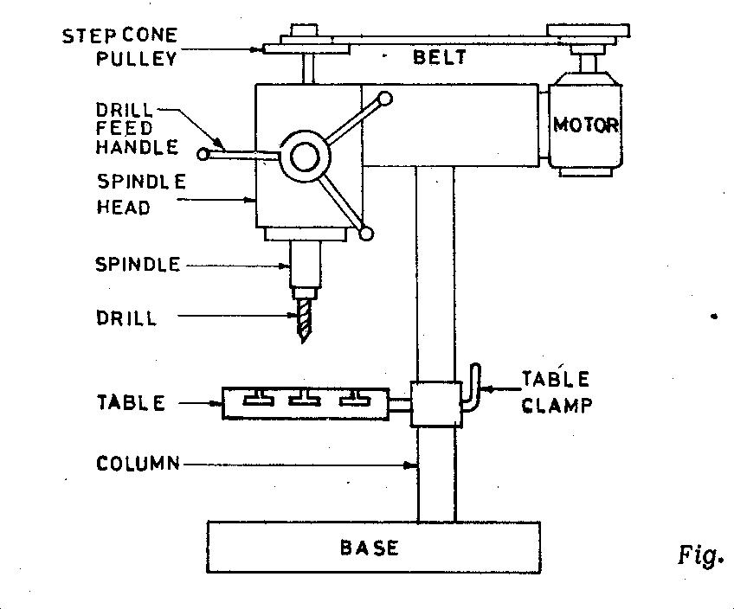
Sensitive Drilling Machine
Drill holes from 1.5 to 15mm
Operator senses the cutting action so sensitive drilling machine

Slide 34
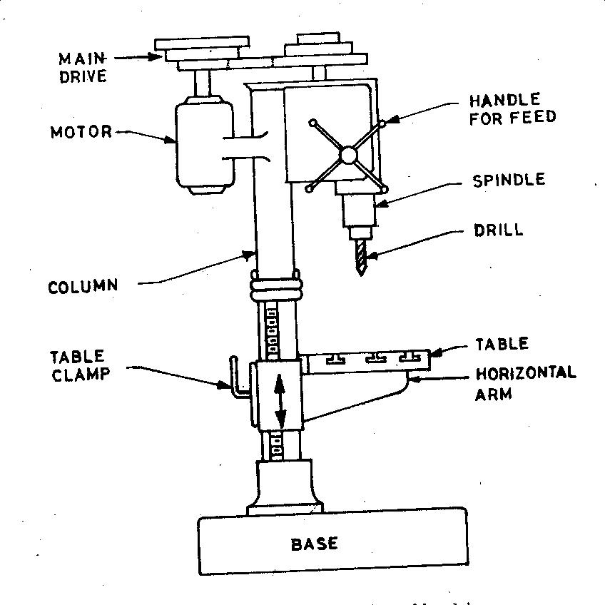
Up-Right Drilling Machine
Drill holes upto 50mm
Table can move vertically and radially

Slide 35
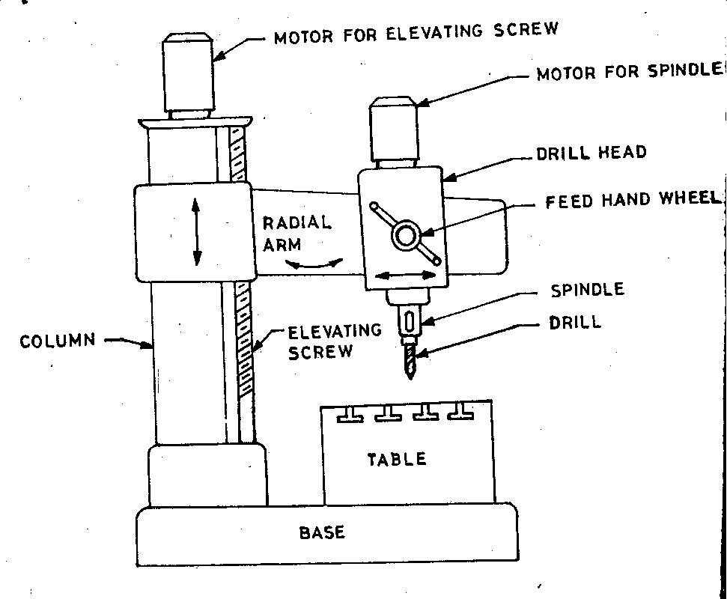
Radial Drilling Machine
It the largest and most versatile used fro drilling medium to large and heavy work pieces.

Slide 36
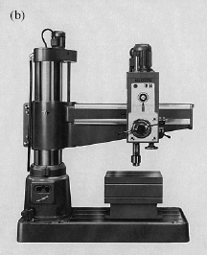

Slide 37
Drill Materials
The two most common types are
1. HSS drill
- Low cost
2. Carbide- tipped drills
- high production and in CNC machines
Other types are
Solid Carbide drill, TiN coated drills, carbide coated masonry drills, parabolic drills, split point drill

Slide 39
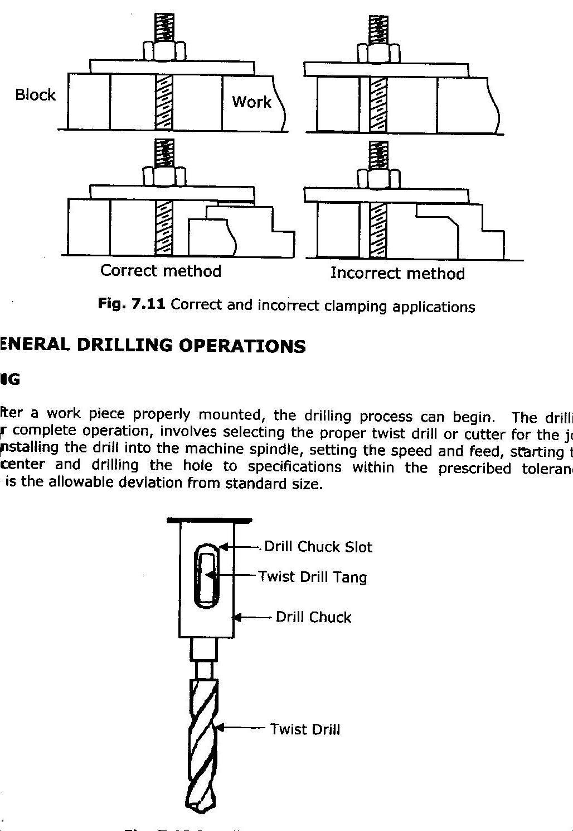
Drill fixed to the spindle
Drilling operations
Drilling Centre Hole
Drilling Deep Holes
Drilling Thin Material
Drilling Pilot Hole

Slide 40
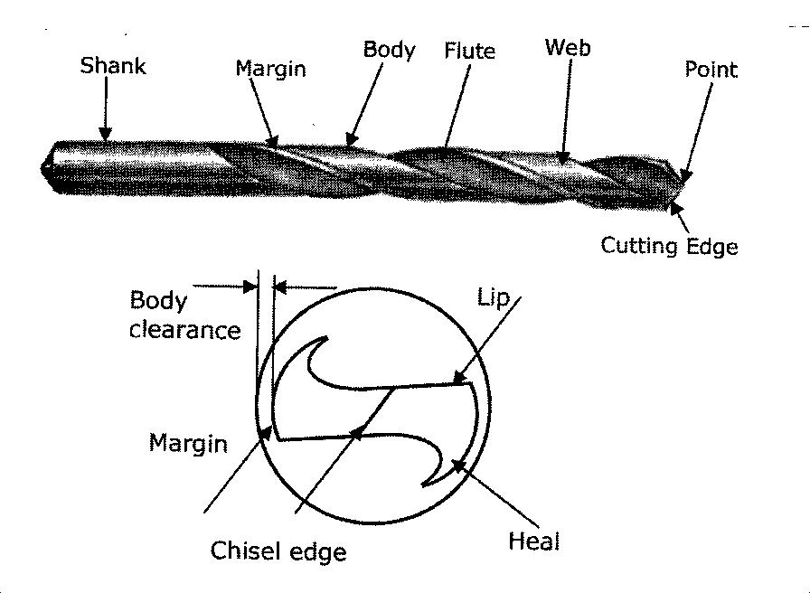
Tool Nomenclature

Slide 41
Tool Holding devices
The different methods used for holding drill in a drill spindle are
By directly fitting in the spindle hole.
By using drill sleeve
By using drill socket
By using drill chuck

Slide 42
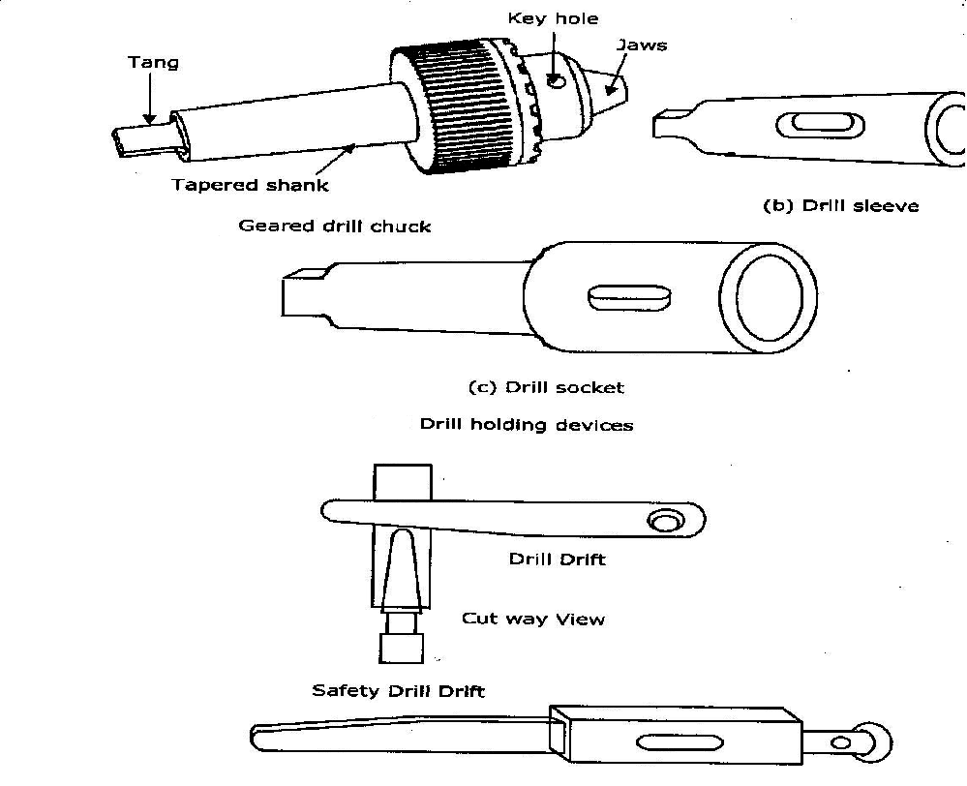
Work Holding Devices

Slide 43
Drilling operations…
Operations that can be performed in a drillin g machine are
Drilling
Reaming
Boring
Counter boring
Countersinking
Tapping

Slide 44
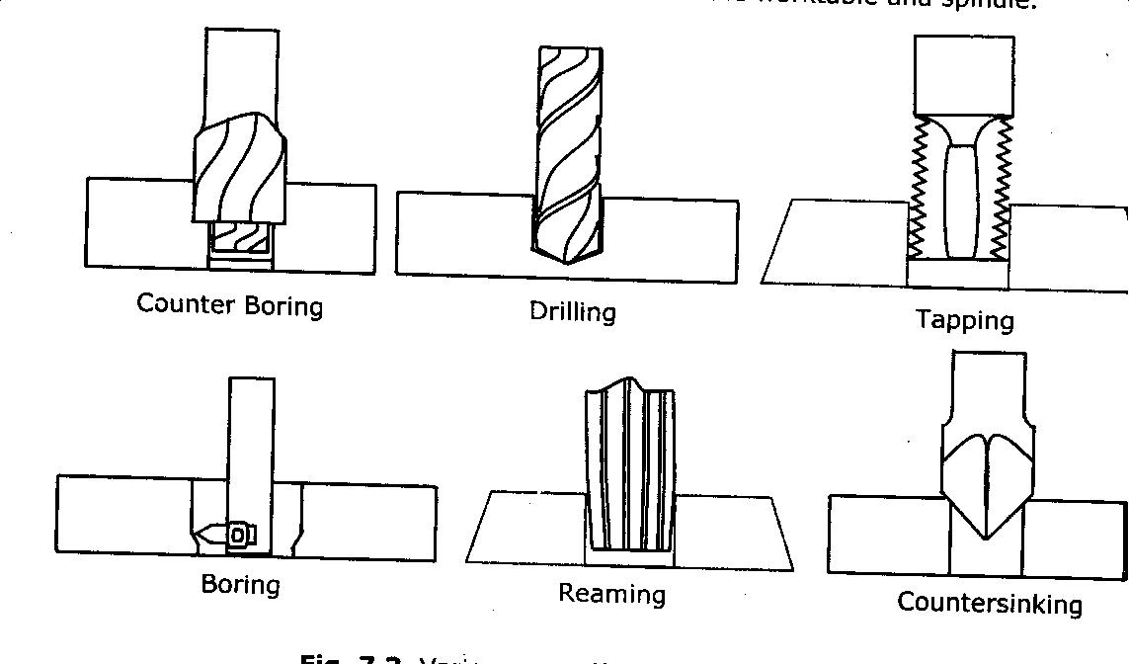
Operations in drilling machine

Slide 45
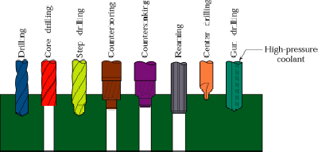
Operations in drilling machine

Slide 46
Types of cutters
Reamers :-
Multi tooth cutting tool
Accurate way of sizing and finishing the pre-existing hole.
Accuracy of ±0.005mm can be achieved
Boring Tool:-
Single point cutting tool.
Boring tool is held in the boring bar which has the shank.
Accuracy of ±0.005mm can be achieved.

Slide 47
Types of cutters
Countersinks :-
Special angled cone shaped enlargement at the end of the hole
Cutting edges at the end of conical surface.
Cone angles of 60°, 82°, 90°, 100°, 110°, 120°
Counter Bore Tool:-
Special cutters uses a pilot to guide the cutting action .
Accommodates the heads of bolts.

Slide 48
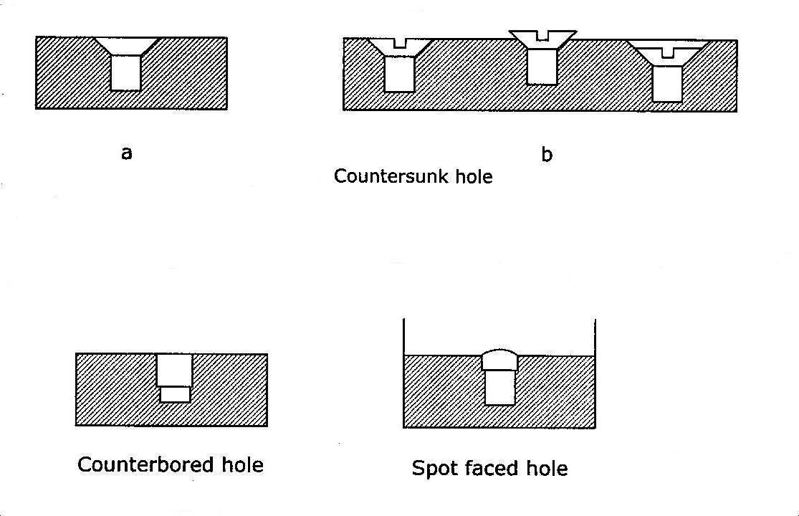
Counter bore and spot facing

Slide 49
Types of cutters
Combined Countersinks and central drill :-
Special drilling tool to start the hole accurately.
At the end it makes countersinks in the work piece.
Gun drill :-
Machining of lengthy holes with less feed rates.
To overcome the heating and short life of the normal drill tool

Slide 50
Types of cutters
Tapping:-
For cutting internal thread
Multi cutting edge tool.
Tapping is performed either by hand or by machine.
Minor dia of the thread is drilled and then tapping is done.

Slide 51
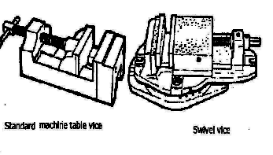
Work Holding Devices
1. Machine Table Vice

Slide 52
Work Holding Devices
Step Blocks
Clamps
V-Blocks
Angles
Jigs
T- Slots Bolt

Slide 53
Definitions
Cutting Speed (v):-
It’s the peripheral speed of the drill
v = Π*D*N where
D = dia of the drill in m
N = Speed of rotation in rpm
Feed Rate (f):-
It’s the movement of drill along the axis (rpm)
Depth of Cut (d):-
The distance from the machined surface to the drill axis
d = D / 2

Slide 54
Material Removal Rate:-
It’s the volume of material removed by the drill per unit time
MRR = (Π D² / 4) * f * N mm³ / min
Machining Time (T) :-
It depends upon the length (l) of the hole to be drilled , to the Speed (N) and feed (f) of the drill
t = L / f N min

Slide 55
Precautions for Drilling machine
Lubrication is important to remove heat and friction.
Machines should be cleaned after use
Chips should be removed using brush.
T-slots, grooves, spindles sleeves, belts, pulley should be cleaned.
Machines should be lightly oiled to prevent from rusting

Slide 56
Safety Precautions
Do not support the work piece by hand – use work holding device.
Use brush to clean the chip
No adjustments while the machine is operating
Ensure for the cutting tools running straight before starting the operation.
Never place tools on the drilling table
Avoid loose clothing and protect the eyes.
Ease the feed if drill breaks inside the work piece.
For more detail contact us

